Slide 1
Mobile Applications Development
React Native: Networking

Slide 2
Last week
Adding style to applications
Designing and implementing navigation

Slide 3
This week
RESTful APIs
OpenAPI specification
Working with APIs
GET requests in React Native
POST requests in React Native
PATCH requests in React Native
DELETE requests in React Native

Slide 4
RESTful APIs

Slide 5
What is a RESTful API?
REpresentational State Transfer
Uses HTTP to communication:
Client-server
Stateless
Uniform interface (HTTP methods)
Not constrained to XML (like SOAP)
Create | POST
Retrieve | GET
Update | PUT or PATCH
Delete | DELETE
Notes:
REpresentational State Transfer
Uses HTTP
- statless
- uses HTTP methods

Slide 6
OpenAPI Specification (OAS)
“The OpenAPI Specification (OAS) defines a standard, language-agnostic interface to RESTful APIs which allows both humans and computers to discover and understand the capabilities of the service without access to source code, documentation, or through network traffic inspection.”
“When properly defined, a consumer can understand and interact with the remote service with a minimal amount of implementation logic.”
Source: https://swagger.io/specification/

Slide 7
But what is it?
It’s a specification for you to define a RESTful API
Routes
Methods
Data format
Parameters
Response codes
Usually written in YAML or JSON (I tend to write in YAML and then convert into JSON)

Slide 8
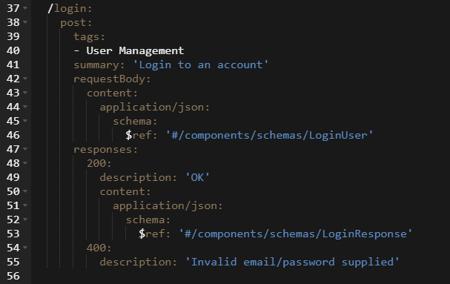
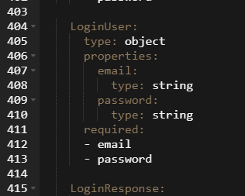
What does it look like?

Slide 9
But why bother?
Can use tools such as Swagger for:
Visualising
Documenting
Testing
Prototyping
Discussing with stakeholders
Can also pull into the code and actually validate requests and responses against the API specification
Notes:
Swagger for visualising, documenting, testing, discussing with stakeholders and prototyping
Pull into code and actually validate requests against the API

Slide 10
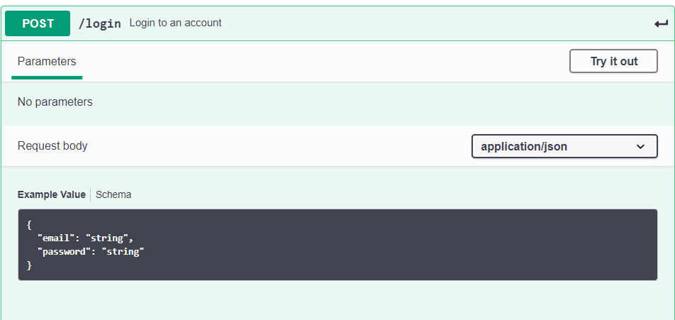
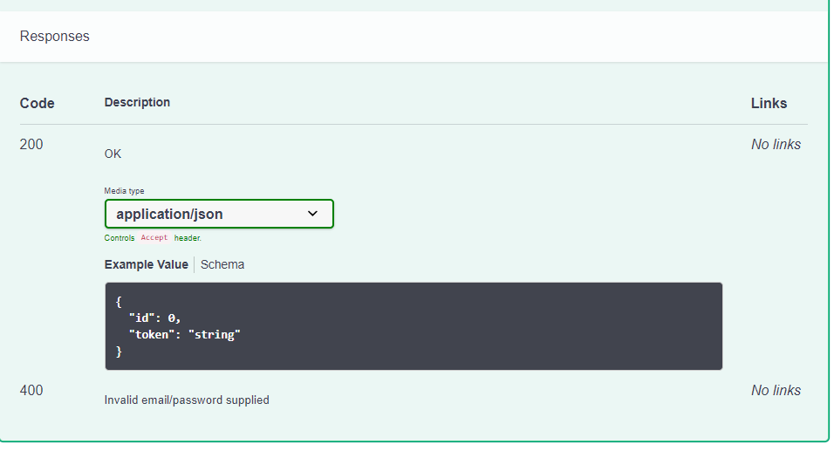
Swagger
https://swagger.io/tools/swagger-editor/
Example (Pet store API):
https://editor.swagger.io/
https://www.youtube.com/watch?v=oxqZ9J6t420 (9 mins)
History/OpenAPI/OSS/The future

Slide 11

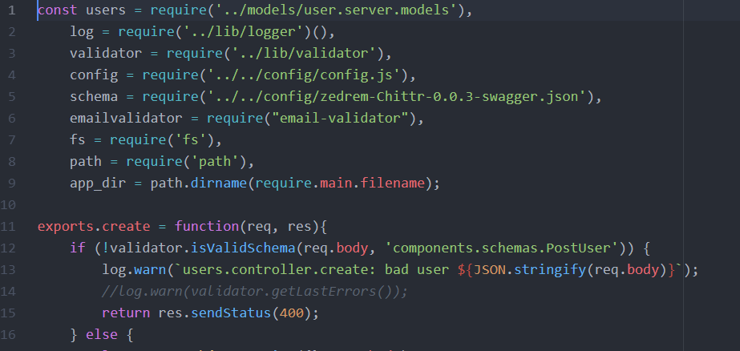
Using the specification within code
Using the Zschema library
Uses a validator library (above)
Using the validator to check incoming requests conform to the specification (right)

Slide 12
Interested in learning to write OpenAPI specifications?
There is a great tutorial:
https://idratherbewriting.com/learnapidoc/restapispecifications.html

Slide 13
Interacting with RESTful APIs in React Native

Slide 14
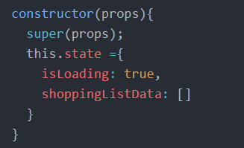
GET request: declaring our state object
First we want to create a variable in our state object to store the data

Slide 15
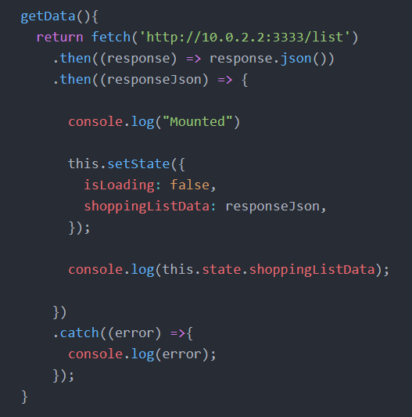
GET request: get the data from the API
Next, write a function that returns the data from the API and stores it in the state object.
By default, the fetch function sends a GET request
Note: fetch drops errors without telling you unless specifically caught

Slide 16

GET request: componentDidMount()
The componentDidMount() function is a feature of React.Component
It is invoked immediately after the component is inserted into the tree (accessed via the application)
In this example, our componentDidMount() should call our getData() function

Slide 17
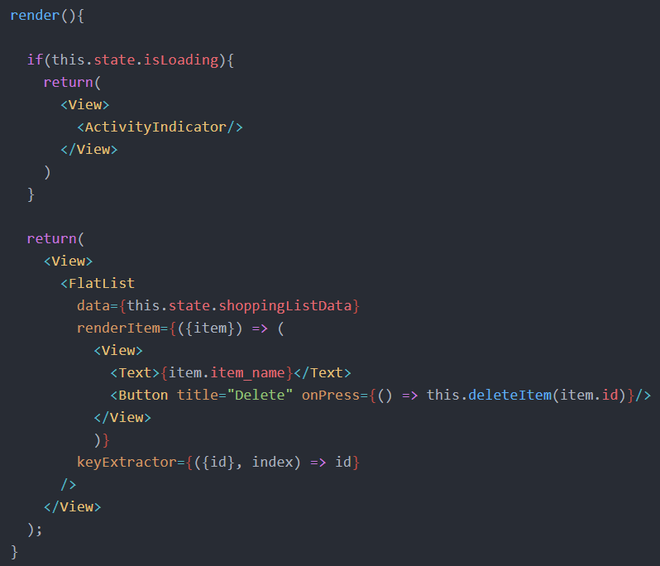
GET request: writing the view
If the isLoading field is true then return an activity indicator (e.g. spinning wheel)
Else, return a FlatList with the names of each item in the list and a button to delete the item.

Slide 18
DELETE request: the buttons invoke a method
With the GET request populating a list, we have a list of items with a button next to them for deleting the item from the list
That button calls the deleteItem function, passing in the ID of the item to be deleted

Slide 19
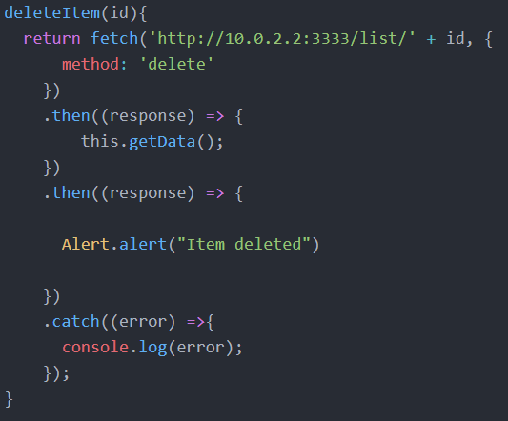
DELETE request: the method
The item ID is appended to the route and the method is changed to DELETE.
If the request is successful then calling the getData function refreshes the state and with it, the items displayed on screen.

Slide 20
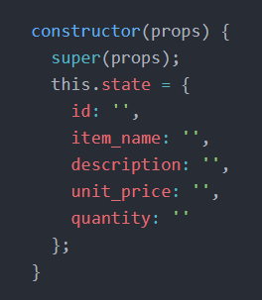
POST request: first we need a placeholder object in state
POST request = create resource (i.e. user is going to fill out a form and submit a new item to add to our list)
For the POST request, we first need an empty temporary object in state to link our form to.

Slide 21
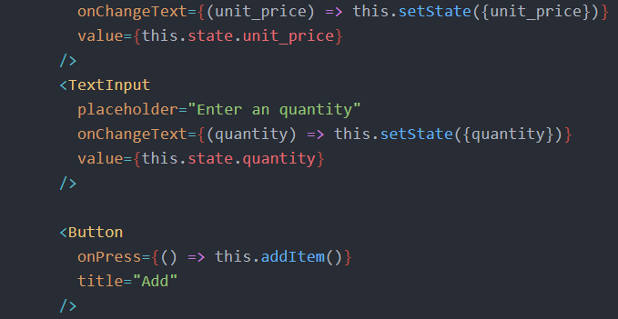
POST request: write the form and link with state
For each field we have a TextInput component. When the text changes, the state is updated with the value.
At the bottom of the form, we have a Button which invokes the addItem function

Slide 22
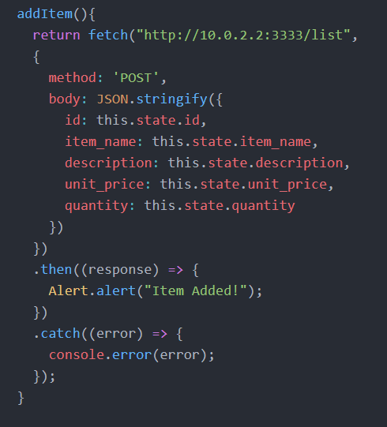
POST request: the addItem method
The fetch method is used to query the API
The method is changed to POST and a JSON object formed from the state is converted to a string and passed into the body

Slide 23
PATCH request: try as part of the lab
Where PUT requests overwrite the entire body of an object, PATCH requests can be used to update just a subset.
PUT requests can be implemented in the same way as POST requests
However, for PATCH requests, you need to dynamically generate an object to send. The object should be populated by the fields that contain different values in the form to what they have in the database/server side (i.e. check if the field has been updated and if so, add it to the form)
Exercise 5 in this weeks lab

Slide 24
Documentation
https://facebook.github.io/react-native/docs/network
Note the async/await example at the bottom of the page

Slide 25
Questions?

Slide 26
Sources
https://www.mulesoft.com/resources/api/what-is-rest-api-design
https://idratherbewriting.com/learnapidoc/pubapis_openapi_step1_openapi_object.html
https://reactjs.org/docs/react-component.html#componentdidmount

